Slide 1
Computational Engineering Mechanics – 2
END SEMESTER PROJECT

Slide 2
BATCH - 14
KARTHIKEYAN M
KARTHIK RAJA B
CB.EN.U4AIE20029
CB.EN.U4AIE20028
NALIN M R
PRAGADISHWARAN K
CB.EN.U4AIE20041
CB.EN.U4AIE20051

Slide 3
GRASHOF RULE
By considering a four‐bar linkage and denoting the length of the bars as a, b, c, and d where:
'a'is the longest bar
'b' is shortest bar
'c' and 'd' are the intermediate‐length bars
A classification can be made based on the studies performed by Franz Grashof (1826 – 1893):
–> (a + b) < (c + d) |  | Grashof mechanism
–>(a + b) > (c + d) |  | non‐Grashofian mechanism
–>(a + b) = (c + d) |  | Extreme case (sometimes called Change‐point mechanism)

Slide 4
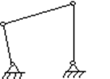
Change Point Mechanism
In the range of planar mechanisms, the simplest group of lower pair mechanisms are four bar linkages. A four-bar linkage comprises four bar-shaped links and four turning pairs as shown in figure
The link opposite the frame is called the coupler link, and the links which is hinged to the frame are called side links. A link which is free to rotate through 360 degrees with respect to a second link will be said to revolve relative to the second link (not necessarily a frame). If it is possible for all four bars to become simultaneously aligned, such a state is called a change point.

Slide 5
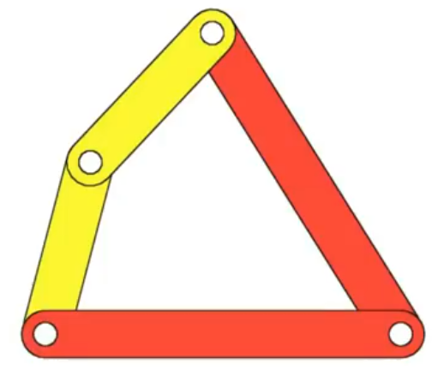
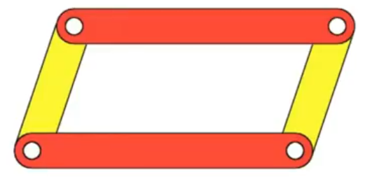
CHANGE POINT FOUR BAR MECHANISM
The change point four-bar mechanism is used for the back and forth motion of the walking machine leg. As the change point mechanism´s sum of two sides is equal to the sum of the other two, the change point mechanism can be positioned such that all of the links become collinear
EXAMPLE MODELS:

Slide 6
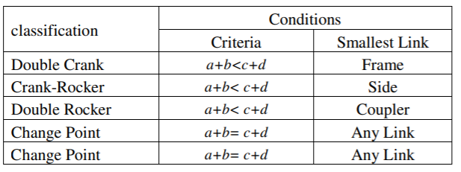
CLASSIFICATION OF FOUR BAR LINKAGES

Slide 7
S + L = P + Q :-
In such kinematic chain , the links become collinear atleast once per revolution of input crank. This case is further divided into two cases :-
Case 1 :- The length of all links are distinct
In this case, the inversions obtained are same as in the case S + L < P + Q. which are :- double crank, double rocker and crank rocker. Case 2 :- The length of any two link are same
If the length of any two links are same, then the length of remaining two links will also be same due to equation S + L < P + Q.

Slide 8
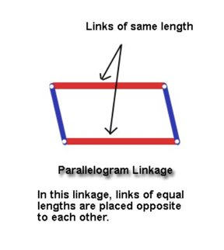
In such case, two linkages are possible base on placement of links:-
a) Parallelogram Linkage :-
If all four links are of equal length, a = b = c = d, the change-point linkage is known as a parallelogram linkage. All four inversions can be double cranks if they can stay in the same branch of the coupler curve
In this linkage, links of equal lengths are placed opposite to each other.

Slide 9
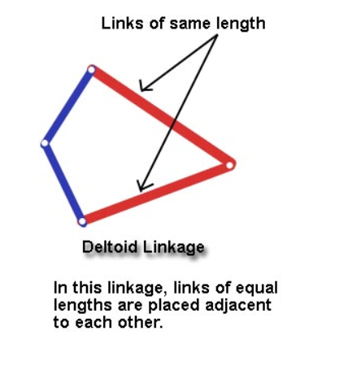
b) Deltoid Linkage :-
In this linkage, links of equal lengths are placed adjacent to each other.
The deltoid linkage is the other special case where two equal length short links are connected to two equal length long links

Slide 10
Parallelogram Linkage and Deltoid Linkage
In both the cases , the inversions obtained are either crank rocker or double crank mechanism. Both these linkage suffer change point condition at the time when the links become collinear.
In change point condition , the motion of output crank become unpredictable. It can go any of the two ways. Based on the motion of the output crank at change point condition, the inversion is crank rocker or double crank .

Slide 11
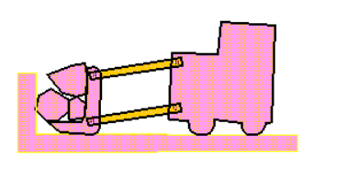
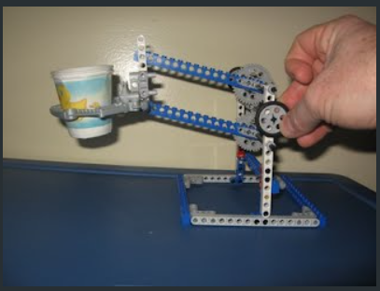
APPLICATIONS OF CHANGE POINT MECHANISMS
In a parallelogram four-bar linkage, the orientation of the coupler does not change during the motion. The figure illustrates a loader. Obviously the behavior of maintaining parallelism is important in a loader. The bucket should not rotate as it is raised and lowered.
The design features two pair of opposite beams of equal length; that determines the parallelogram.Then, as the sides move in response to the turning axle, the opposite sides remain parallel. The cup of water does not spill because it maintains its orientation with respect to the floor for the entire lifting process.

Slide 12
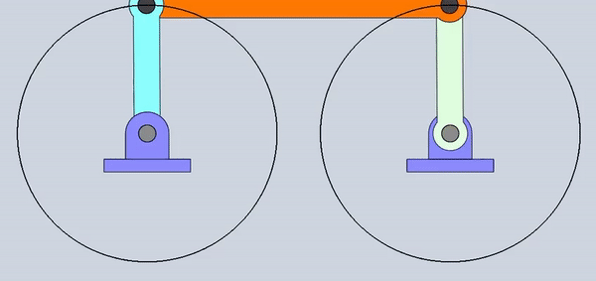
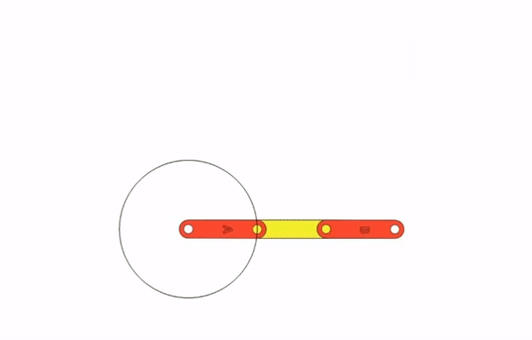
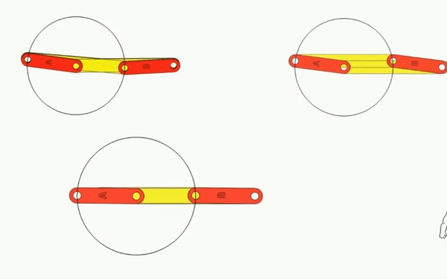
Examples of Change point Mechanism

Slide 13
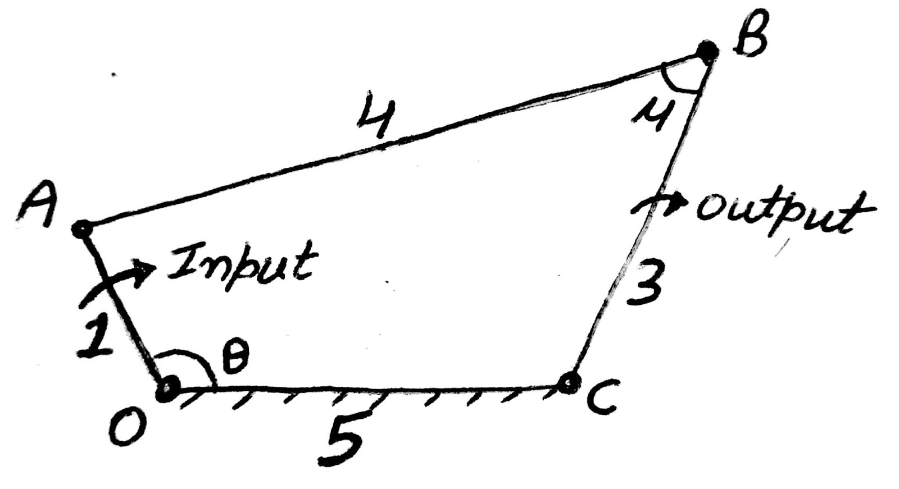
TRANSMISSION ANGLE
Transmission angle is the angle between the coupling member and the output member in a mechanism. The angle between the direction of absolute motion and direction of the relative motion of the point in which the driven member gets the motion impulse Transmission angle of mechanism.

Slide 14
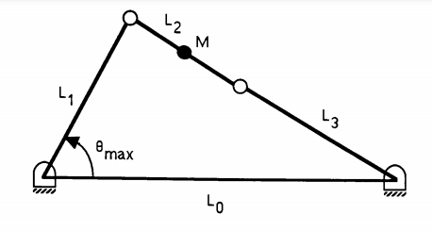
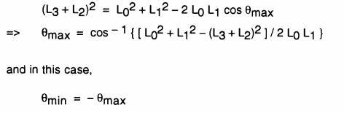
TRANSMISSION ANGLE

Slide 15
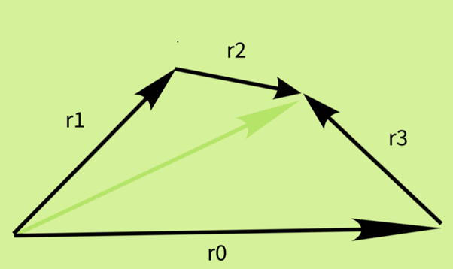
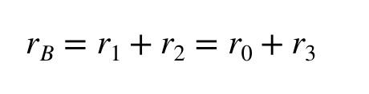
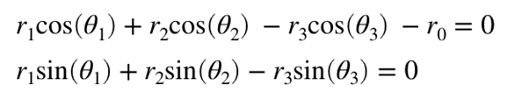
POSITION ANALYSIS

Slide 16
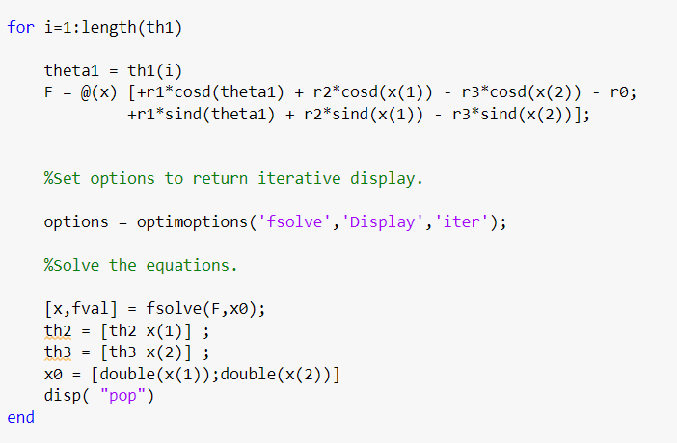
IN CASE OF SOLVING NON LINEAR EQUATIONS IN THE POSITION ANALYSIS STEP

Slide 17
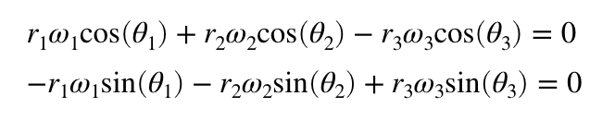
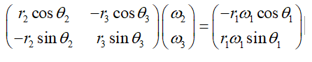
VELOCITY ANALYSIS
We differentiate the position analysis to find out velocity equations.
The equation is in the form AX=b Since the unknowns are present in the matrix X We solve the unknowns using X=(A^-1)*B

Slide 18
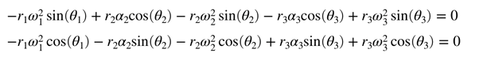
ACCLERATION ANALYSIS
We differentiate the Velocity analysis step to find out acceleration equations.
Following the similar process to that of velocity analysis we find out the unknowns that is α2, α3.
The acceleration of the driving link will be 0

Slide 19
CODE LOGIC:
First we take the link lengths as input s
Next we check whether it satisfies : s+l = p+q condition
We perform the positional analysis of the mechanism by representing the links in the form of sin and cos components and finding the unknowns where we have initial angular velocity taken at a particular value
We follow a fsolve method in matlab by giving an initial guess value in order for solving the non linear equations and finding the unknowns corresponding to that.
We differentiate the position analysis step to get velocity equations and then we get acceleration by differentiating velocity equations.

Slide 20
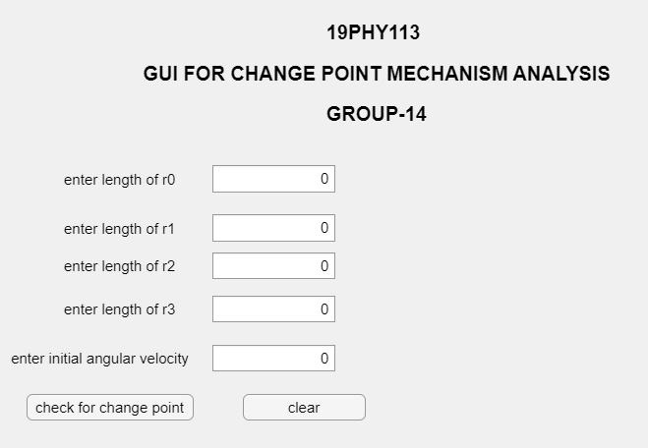
OUTPUT

Slide 21
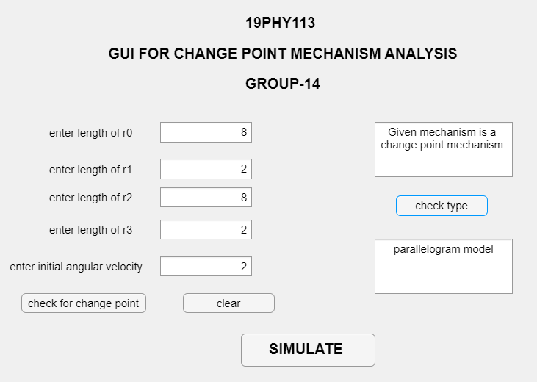
OUTPUT

Slide 22
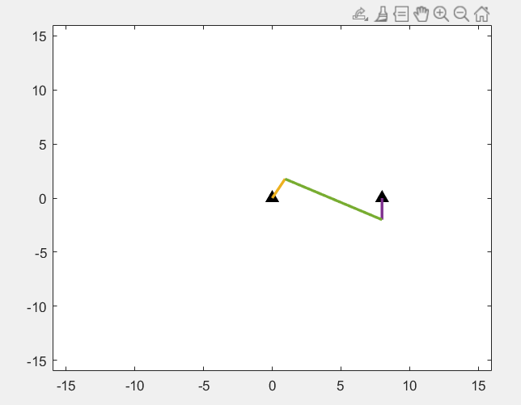
OUTPUT

Slide 23
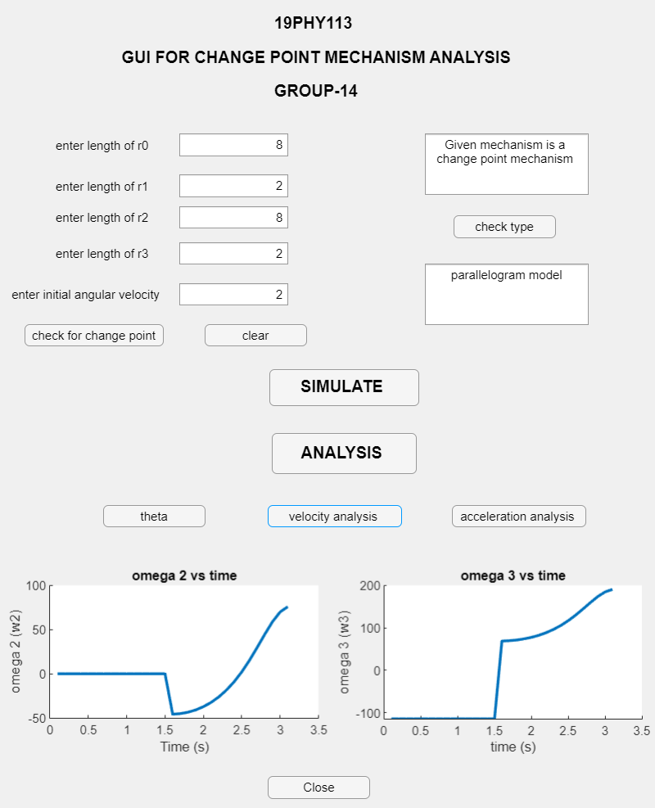
OUTPUT

Slide 24
DEMO

Slide 25
THANK YOU

